Slide 1


Python Fundamentals
Innovation Masters
Day 3

Slide 2
Today’s Agenda
Go over homework, google drive folder
Finish learning about variables
Understand text/String
Make a few programs
Tech talk

Slide 3
Variable types
There are different types of data a variable can store: int, float(decimal), String, Boolean, and more
Python does not require you to declare a variable. All you do is assign a variable a value.
type() method tells you the type of a variable
== checks if two pieces of data are equal or not

Slide 4
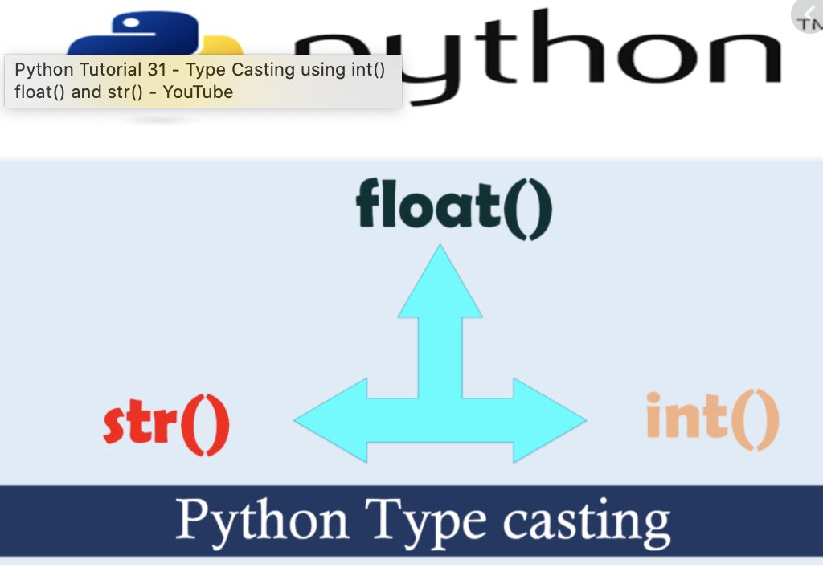
Type casting
Converting variables from one type to another
Common conversions:
float to int
String to int and float
int and float to String
Ex: x = int(“10”)
y = float(input(“Enter decimal: “))

Slide 5

That’s all for variables

Slide 6
Print Emojis in Python
# grinning face print("\N{grinning face}") # slightly smiling face print("\N{slightly smiling face}") # winking face print("\N{nauseated face}")
More emojis can be found here:
https://www.geeksforgeeks.org/python-program-to-print-emojis/

Slide 7







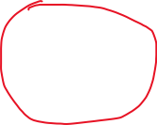

Strings/text
What is a String?
Simply one thing stringed with another and another to have a collection
Ex: cabins stringed together to form train, rings stringed together to form bracelet/necklace
In programming String is a collection of characters
What are characters?
abAb12 _=@!*{ even space is a character
Every text is a String of characters

Slide 8
Instantiate/declare a String
Instantiate means to to introduce or make a variable
demoVariable = “Some text”
demoVariable = input(“Whatever you want to ask for: “)

Slide 9
Operators on Strings
Add/Concatenate – a String is added to the end of the first one
You can only add strings with other strings
It doesn’t make any sense if you add string with int or float
Multiply – repeats the String by the indicated amount

Slide 10
Some String Methods
I will show you guys some methods but there are many
count(“character”) - counts how many times the character appears in a String
Ex: demoVariable = “Every cent counts.” , print(demoVariable.count(“c”)) - 2
len() - returns the length of the String or how many characters there are
Ex: print(len(stringVariable)) , numChar = len(stringVariable)
in - checks if a specified String is in another String
Ex: print(“Test” in “Testing”) - True
Ex: demoVariable = “Hello”, print(“hel” in demoVariable) - False

Slide 11
String Documentation
https://docs.python.org/3/library/string.html
https://www.w3schools.com/python/python_ref_string.asp

Slide 12
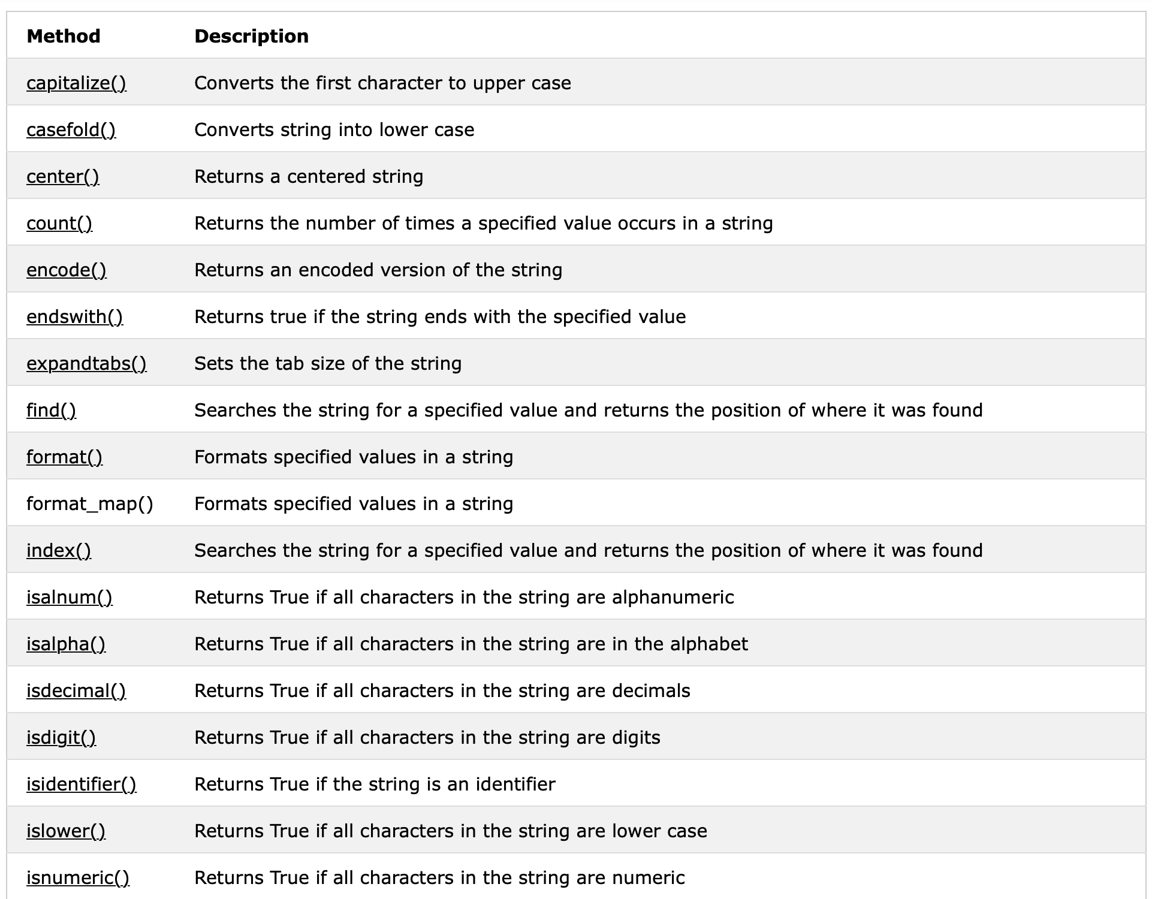
HOMEWORK
Try using all the String methods and explore how they vary and how you can use them for different purposes
Try all methods except for the ones that are marked off

Slide 13
Homework
For some of the methods you might need to put information inside the parentheses

Slide 14
Tech Talk
https://www.youtube.com/watch?v=uKcZxwTAVEM&t=29s
Who else has something to share?

